Slide 1



TRAVEL COST MINIMIZATION IN SMART CITIES USING DYNAMIC PROGRAMMING
Project Guide : Mr.Gopi
Team members:
Kalla Varshitha – 23891A0524
Mahankali Neha – 23891A0532
Koyagorra Venu – 23891A0529
Gunti Charan – 23891A0518

Slide 2
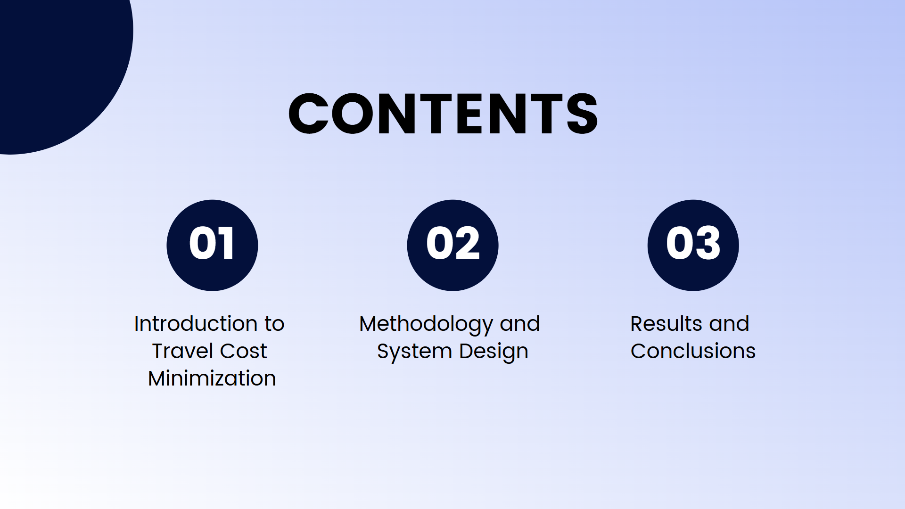

Slide 3
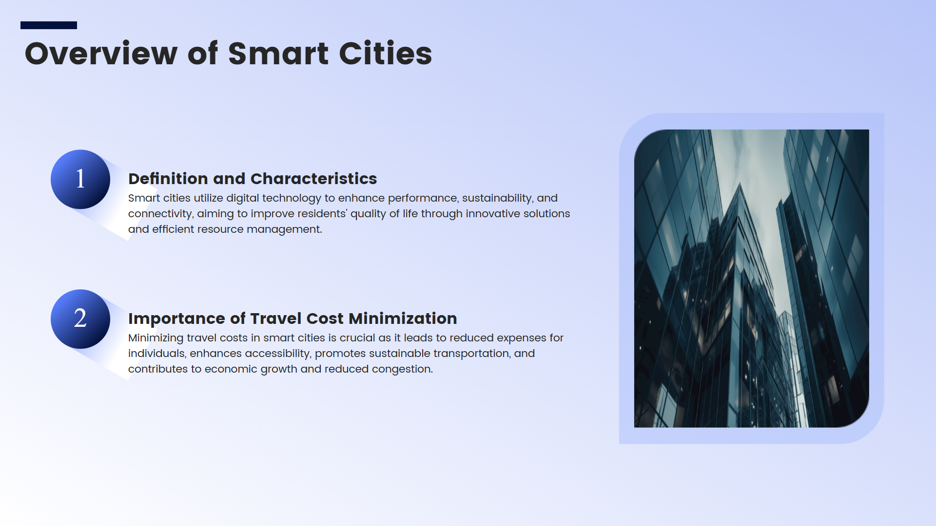

Slide 4
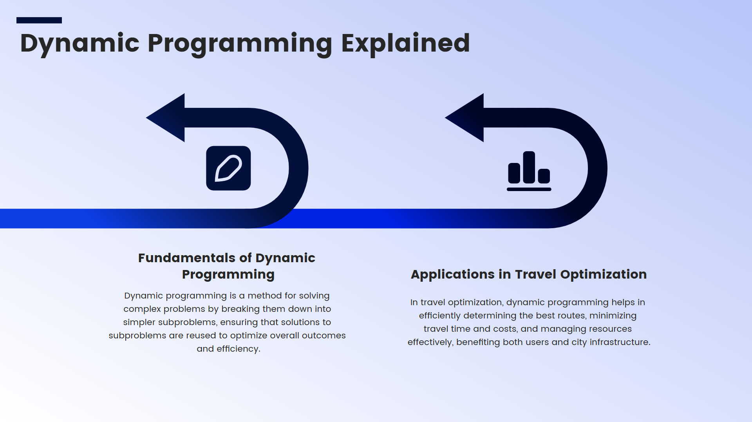

Slide 5
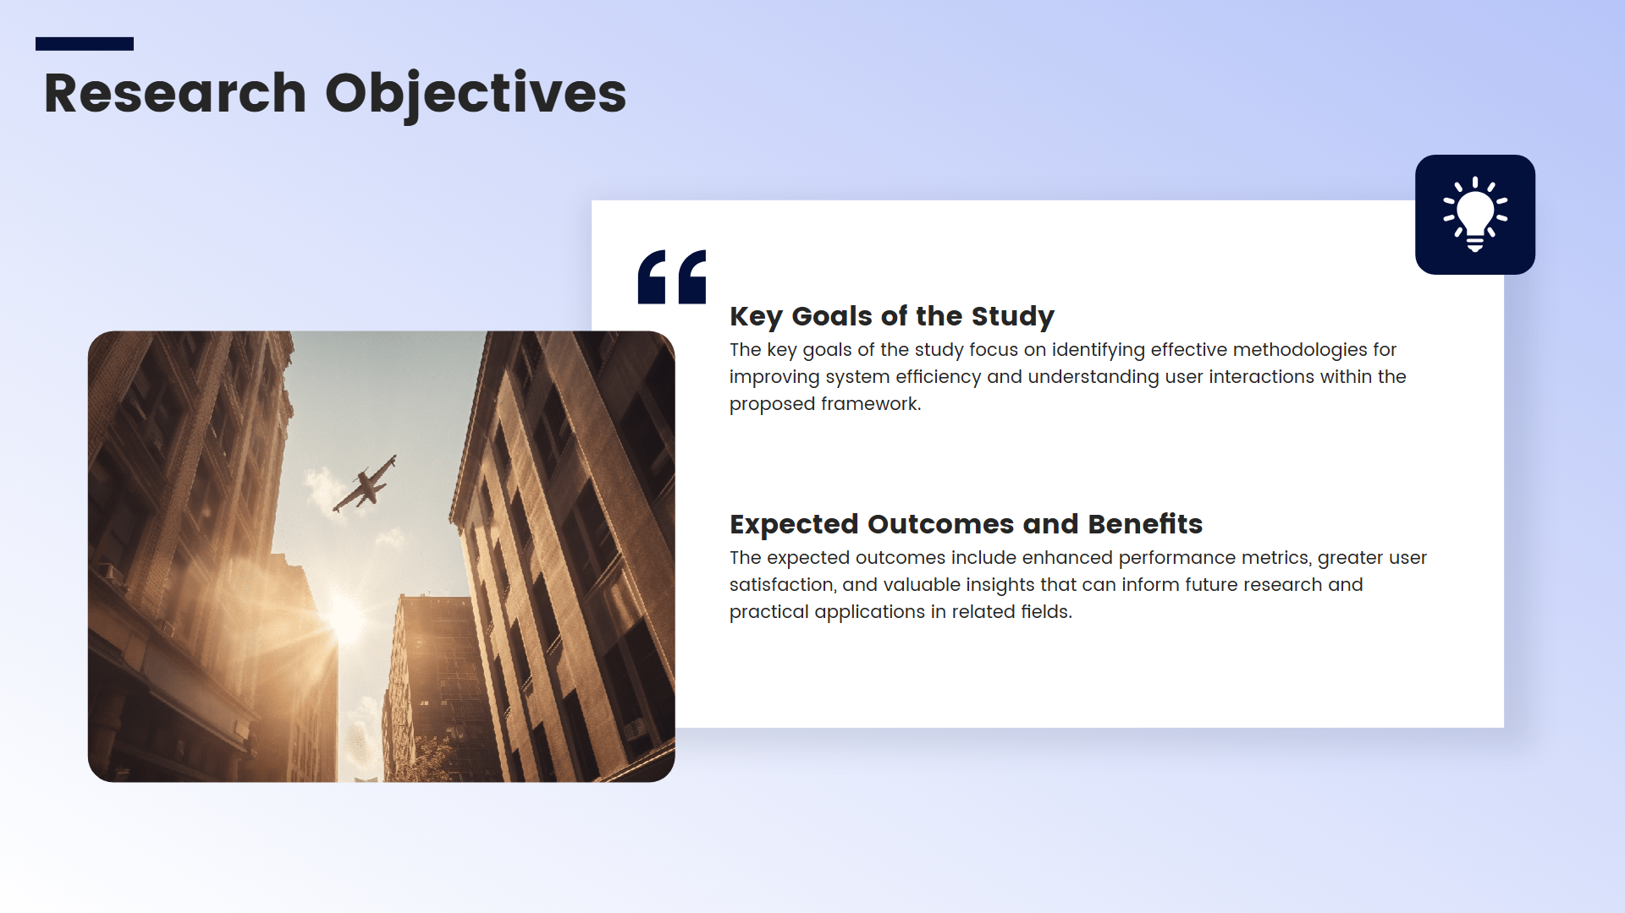

Slide 6
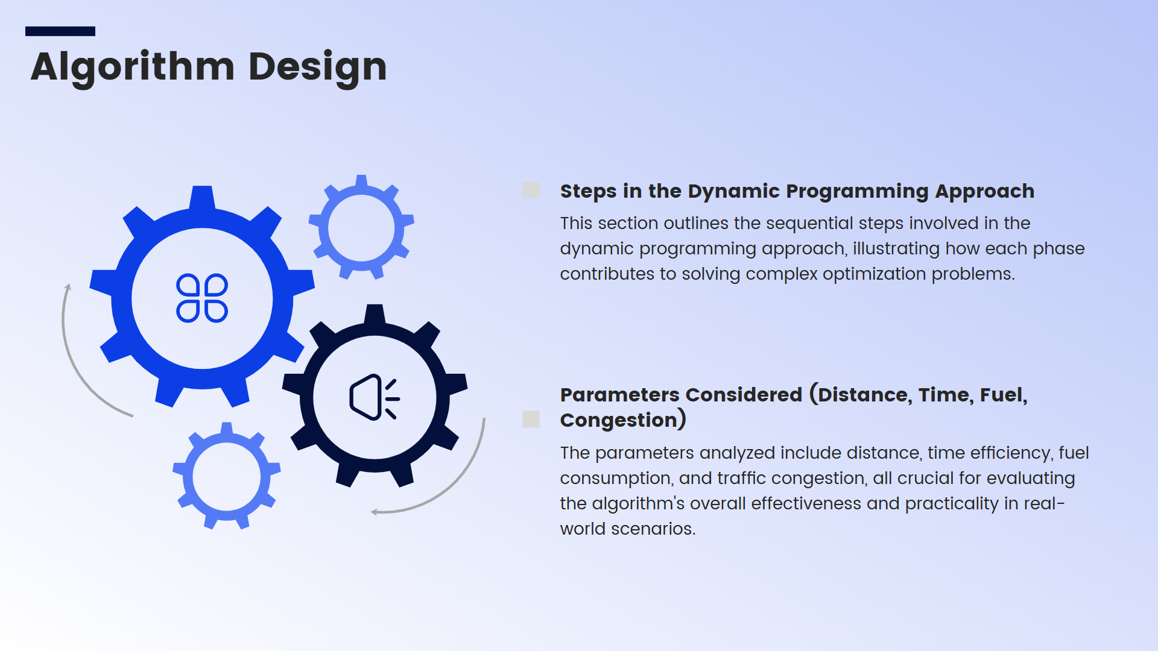

Slide 7
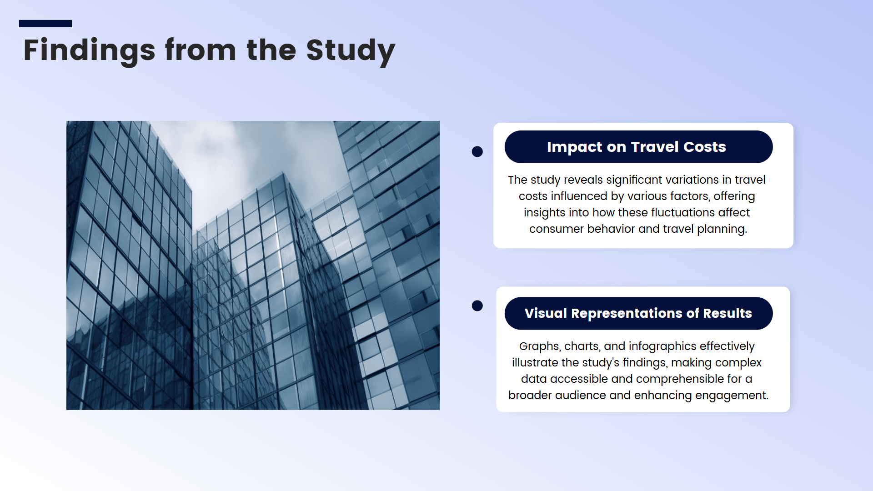
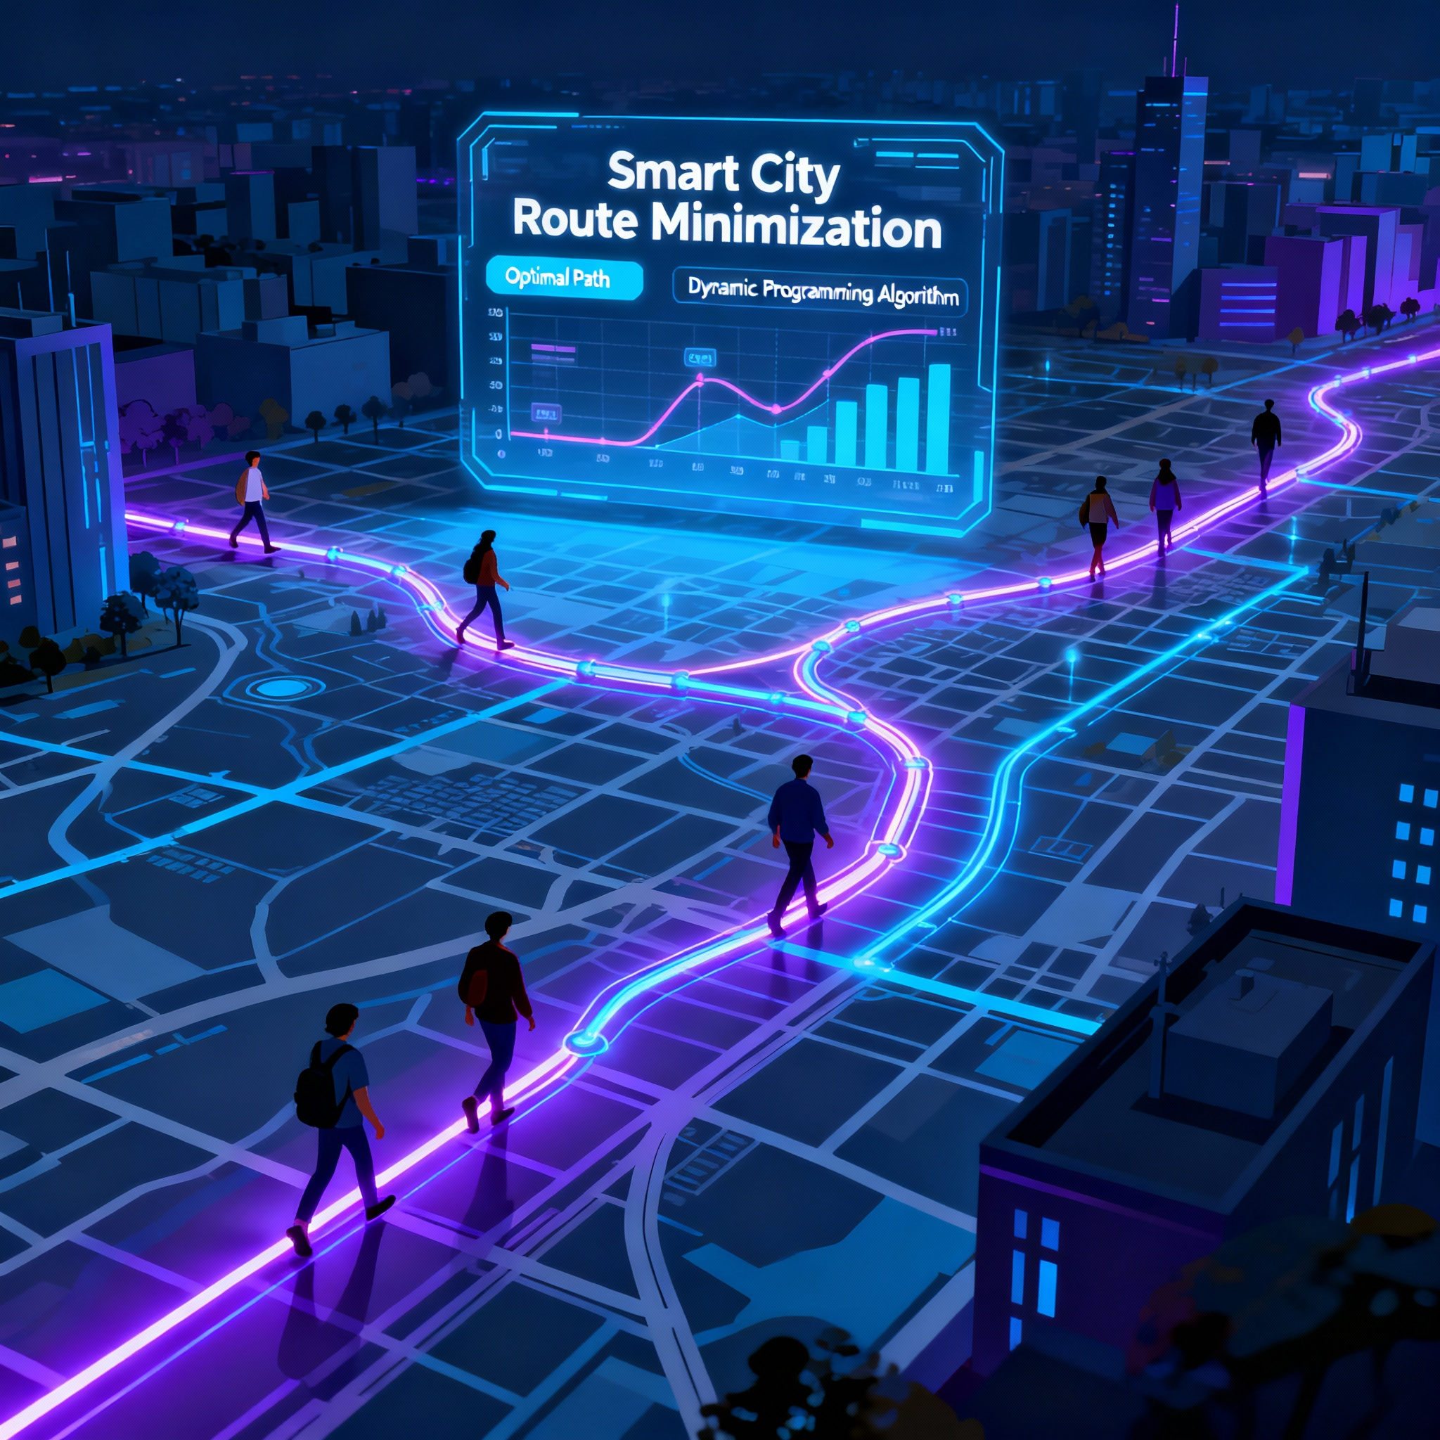

Slide 8
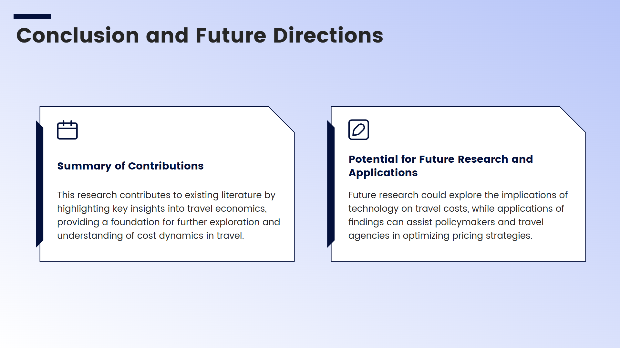

Slide 9
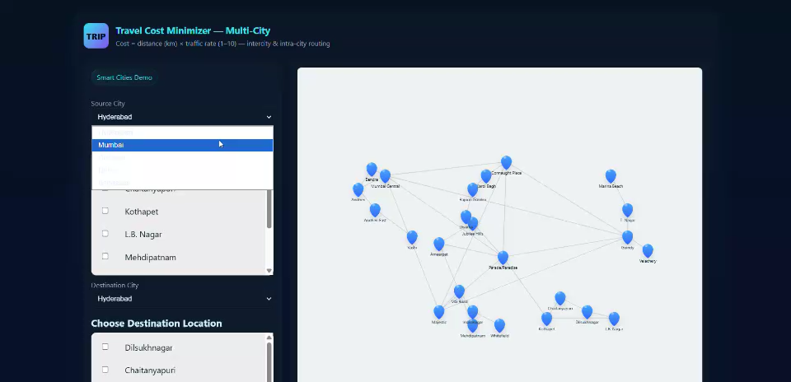
OUTPUT

Slide 10
THANK YOU

